Slide 1
3 model tayyorlash bosqichlari (Koordinatalar bilan ishlash)
Urishev Adhamjon Ergashaliyevich
93.5725069

Slide 2
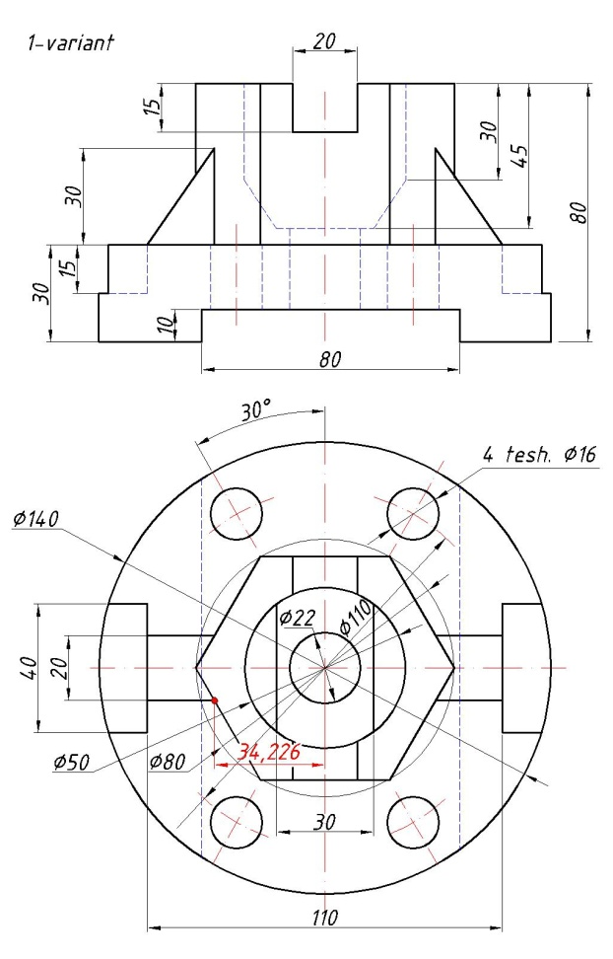
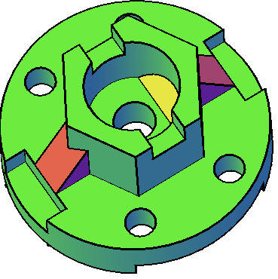
1-detal chzimasi o’qiladi (qanday geometrik primitivlardan tashkil topgani va ularning pozision holati aniqlanadi).

Slide 3

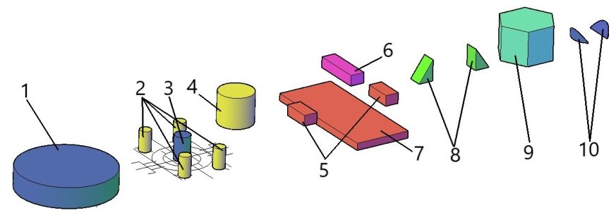
Buyum analizi
1-silindr 1; 2 (4ta); 3; 4.
2- yashik 5; 6; 7.
3-pona 8.
4-prizma 9.
5-kesik silindr

Slide 4

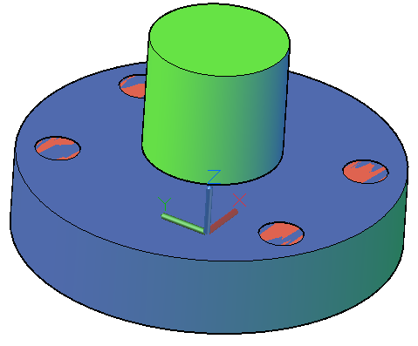
Silindr 0,0,0 ↵ 70↵ 30↵
Silindr 55<60↵ 8↵ 30↵
Silindr 55<120↵ 8↵ 30↵
Silindr 55<240↵ 8↵ 30↵
Silindr 55<300↵ 8↵ 30↵
Silindr 0,0,35↵ 25↵ 45↵
7. Silindr 0,0,10↵ 11↵ 35↵

Slide 5




Yashik 7 -40,70↵ 40,-70↵ 10↵
Yashik 5 -55,20,15↵ -70,-20,15↵ 15↵
Yashik 5 55,20,15↵ 70,-20,15↵ 15↵
Yashik 6 -10,40,65↵ 10,-40,65↵ 15↵
Klin 8 -34.226,10,30↵ -55,-10,30↵ 30↵
Klin 8 34.226,10,30↵ 55,-10,30↵ 30↵
Mnogogrannik 9 6↵ 0,0,30↵ В↵ 40↵
Vidavit obekt↵ 50↵
Obeydineniue obekt+obekt+obekt+obekt↵
Vichitaniye obekt↵ 9ta obekt↵

Slide 6
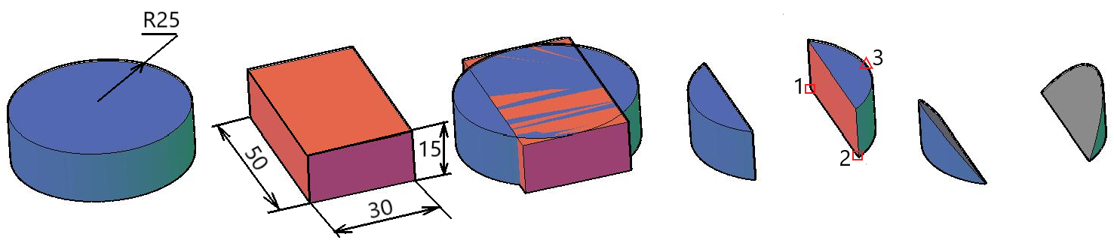
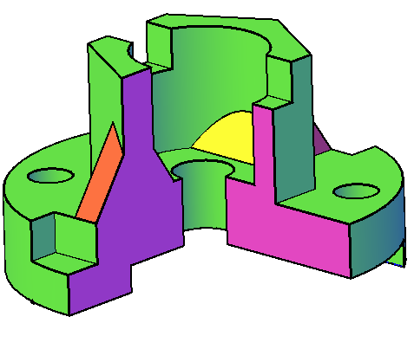
Slindr radius 25 balandlik 15
Yashik uzunligi 30 kengligi 50
balandligi 15
Surish obekt↵ markaz↵ 0,0,35↵

Slide 7
